Slide 1
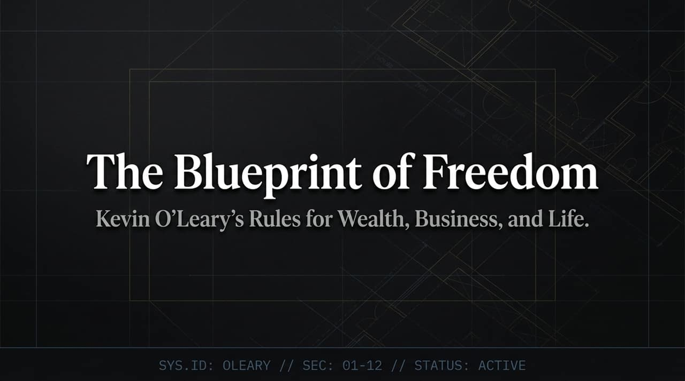
Notes:
Introduction: Welcome, everyone. Today we are diving into 'The O'Leary Protocol'—a systematic blueprint for wealth, business, and personal freedom. When people look at Kevin O'Leary, they often see a tough-talking TV investor. But behind the television persona lies a precise, mathematical methodology for living a life of absolute financial autonomy.
The Thesis: Money is not the ultimate goal. Money is merely a tool that buys you the most valuable asset on earth: control over your time. Today’s presentation synthesizes Kevin’s fundamental principles spanning career selection, relentless focus, investment discipline, hiring strategies, and personal governance.
Transition: Let’s begin where Kevin’s journey truly started—with a pivotal, defining moment that forever altered how he views the world.
https://www.youtube.com/watch?v=mpAZehPviLQ

Slide 2
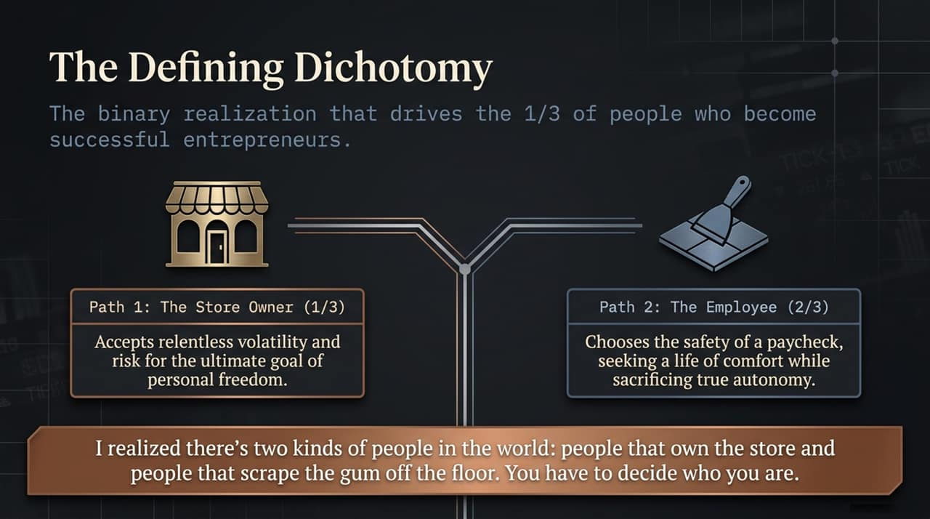
Notes:
The Origin Story: In his early years, Kevin took a job at an ice cream shop. On his very first day, after hours of scooping, the owner ordered him to get on his knees and scrape chewing gum off the linoleum floor. Kevin refused and was fired on the spot. That humiliation created a permanent awakening.
The Dichotomy: From that moment, Kevin realized the world is divided into two distinct groups:
Path 1 (The Store Owner / Entrepreneur): The 1/3 of people who embrace total volatility, responsibility, and risk in exchange for eventual, uncompromised freedom.
Path 2 (The Employee): The 2/3 who choose the perceived security of a steady paycheck, trading away their autonomy to build someone else’s dream.
Key Takeaway & Transition: Neither path is inherently wrong, but you must make a conscious choice. If you want true freedom, you must be willing to own the store. But owning the store requires extreme discipline, starting with how you manage your focus.

Slide 3
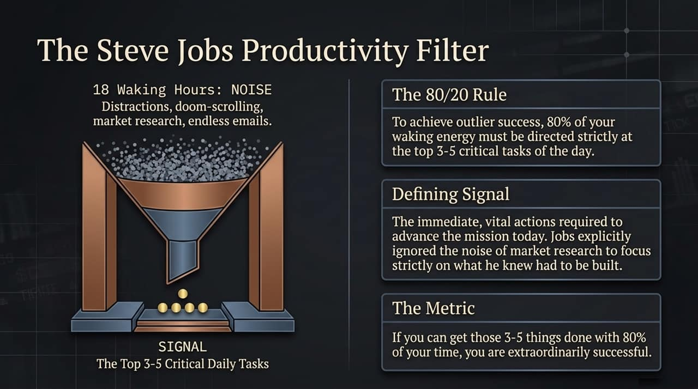
Notes:
The Lesson from Steve Jobs: During his time working with Steve Jobs at Apple Educational Software, Kevin observed a rare trait among top performers: an incredible filter for signal versus noise.
Breaking Down Signal vs. Noise: In an 18-hour day, most of what comes at us is Noise—endless emails, doom-scrolling, irrelevant market chatter, and minor administrative fires. Signal, however, consists of the critical 3 to 5 vital tasks that directly advance your core mission today.
The Metric of Success: To achieve outlier success, you must direct 80% of your waking energy solely to those 3 to 5 critical tasks. Jobs famously ignored market research focus groups to focus strictly on building what he knew was necessary. If you accomplish those key tasks daily, you are winning.
Transition: Once you master internal focus, how do you communicate your mission to the outside world? It comes down to a precise 90-second framework.

Slide 4
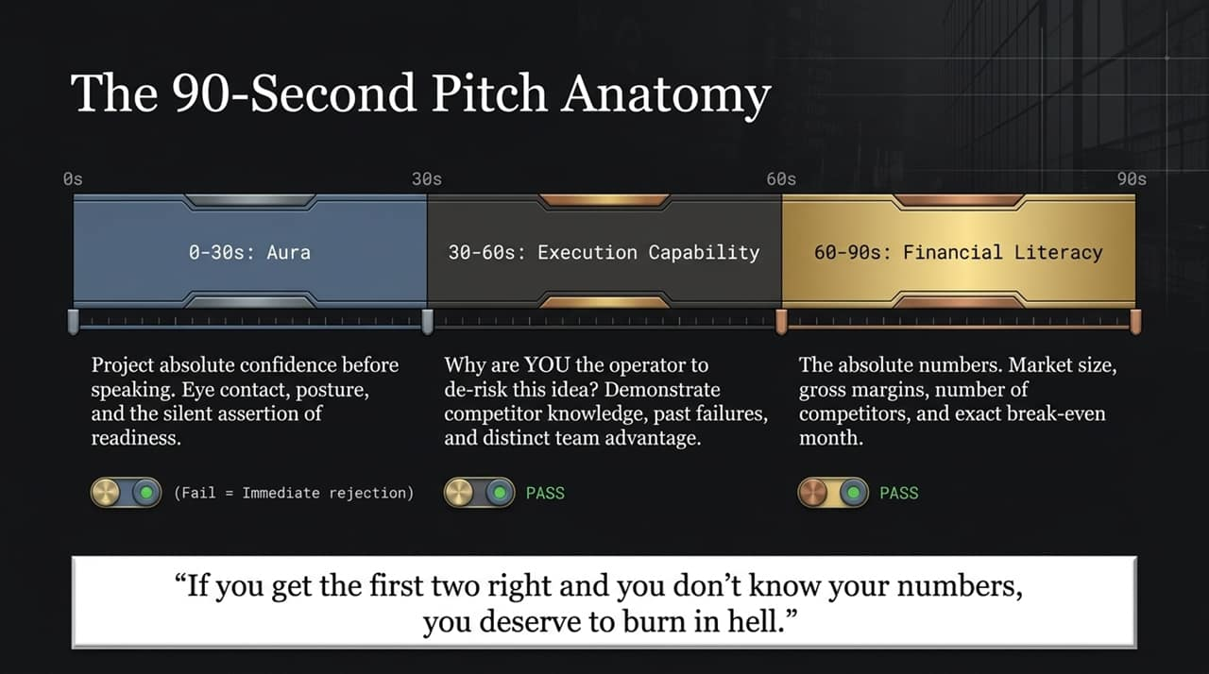
Notes:
The First 30 Seconds — Aura & Presence: In any pitch or high-stakes negotiation, the first 30 seconds are about Aura. Before you even state your metrics, you must project absolute posture, eye contact, and quiet confidence. Failing here means immediate mental rejection from investors.
30 to 60 Seconds — Execution Capability: The next 30 seconds answer one question: Why are YOU the operator to de-risk this idea? Ideas are cheap; execution is everything. Show your deep domain expertise, past lessons, and distinct competitive moat.
60 to 90 Seconds — Financial Literacy: The final 30 seconds demand cold, hard numbers: market size, gross margins, CAC, break-even timeline, and competitor landscape. As Kevin famously states: 'If you get the first two right and you don't know your numbers, you deserve to burn in hell.'
Transition: Once you have pitched successfully and raised capital, your next major hurdle is building the execution engine by hiring the right people.

Slide 5
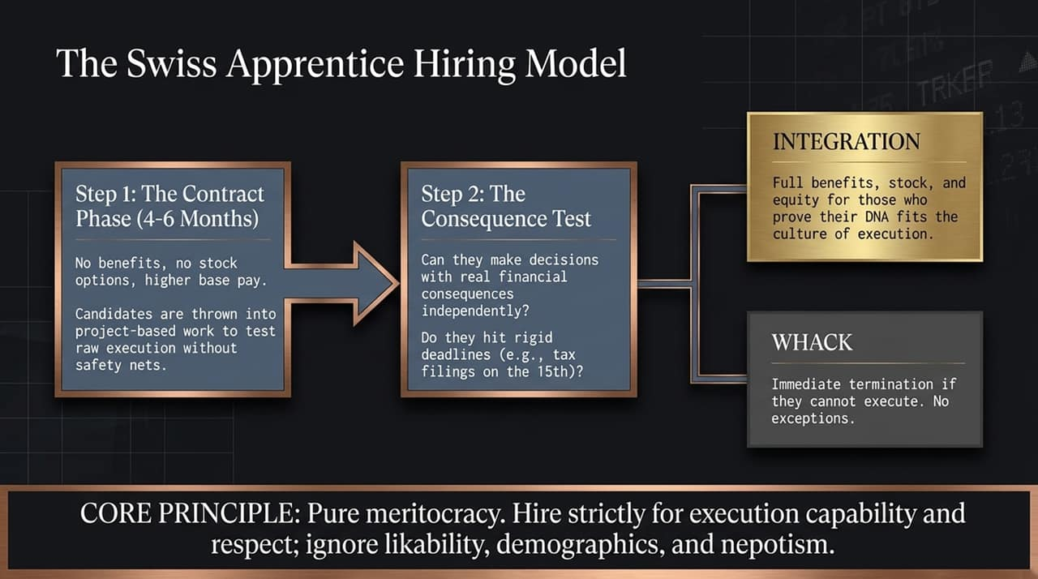
Notes:
Step 1: The Contract Phase (4–6 Months): Traditional hiring relies on polished resumes and charming interviews, which often fail. Kevin advocates for a Swiss-style probationary framework: candidates are hired on short-term project contracts with a higher base pay but zero equity or benefits upfront.
Step 2: The Consequence Test: During this period, candidates are given real projects with tangible financial consequences. Can they execute without hand-holding? Do they hit rigid deadlines (e.g., tax filings or product launches) under pressure?
Integration vs. Termination: If their DNA aligns with high-execution culture, they are integrated with equity, stock options, and full benefits. If they fail, they are terminated immediately—'whacked' without emotional delay. Hire purely for merit, competence, and respect; ignore likability or politics.
Transition: Now that we’ve covered business operations and hiring, let’s look at how to protect and compound the capital you generate.

Slide 6
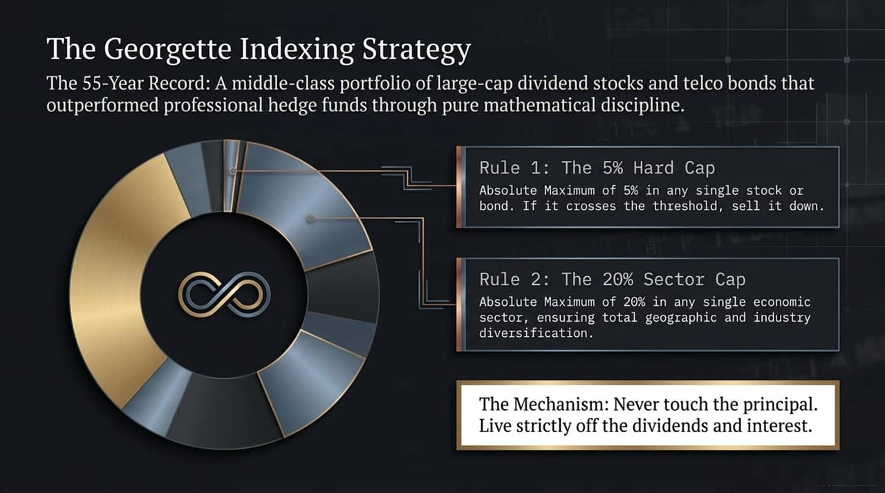
Notes:
The Origin of the Strategy: Kevin’s investment philosophy was inherited from his mother, Georgette. After her passing, the family discovered she had secretly built an investment portfolio of large-cap dividend stocks and telco bonds that consistently outperformed professional hedge fund managers over 55 years.
The Two Ironclad Rules: Her strategy rested on two strict mathematical rules:
Rule 1 (5% Hard Cap): Never allocate more than 5% of your total portfolio to a single stock or bond. If a winning asset grows to exceed 5%, trim it down immediately.
Rule 2 (20% Sector Cap): Never allocate more than 20% of your portfolio to any single industry sector.
The Wealth Mechanism: The fundamental directive is simple: Never touch the principal; live strictly off the dividend yield and interest stream.
Transition: Building wealth requires adhering to these investment rules, but keeping wealth requires avoiding daily consumer traps.

Slide 7
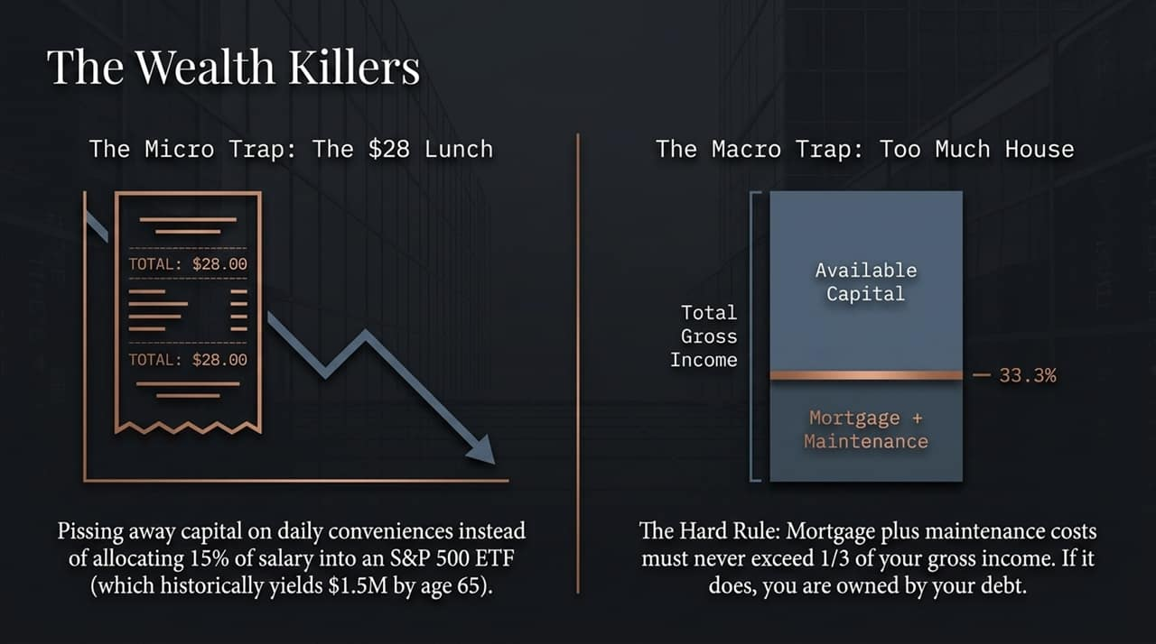
Notes:
The Micro Trap ($28 Lunches): Wealth isn't just lost in bad business deals; it bleeds out in daily micro-leaks. Spending $28 daily on takeout lunches or specialty coffees seems harmless, but compounding that capital at standard market returns (investing 15% of income into an S&P 500 ETF) yields over $1.5 million by age 65.
The Macro Trap (Too Much House): On a macro level, the biggest blunder people make is buying too much real estate. The Hard Rule: Mortgage payments plus property maintenance costs must never exceed 33.3% (1/3) of your total gross income. Exceeding this threshold turns your home into a debt anchor.
Key Takeaway & Transition: Stop letting convenience and over-leveraged housing ruin your long-term independence. Next, let's examine how personal relationships impact financial survival.

Slide 8
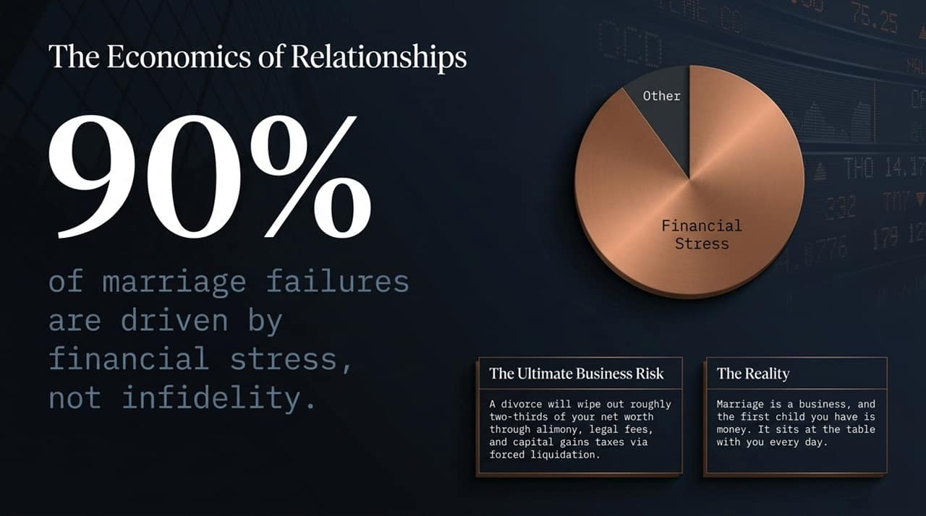
Notes:
Statistical Reality: Over 90% of marriage failures stem directly from financial stress and divergence in money management, far outpacing infidelity.
Divorce as a Capital Risk: In business terms, a divorce is a catastrophic event that can wipe out up to two-thirds of your liquid net worth through legal fees, alimony, and forced asset liquidations.
Marriage is a Business: Treat marriage with the financial seriousness it demands. 'The first child you have in a marriage is money—it sits at the dinner table with you every single day.' If both partners aren't aligned on how that 'child' is fed and managed, conflict is inevitable.
Transition: How do you evaluate potential partners before making a lifelong commitment? Let's review the 5 Financial Personas.

Slide 9
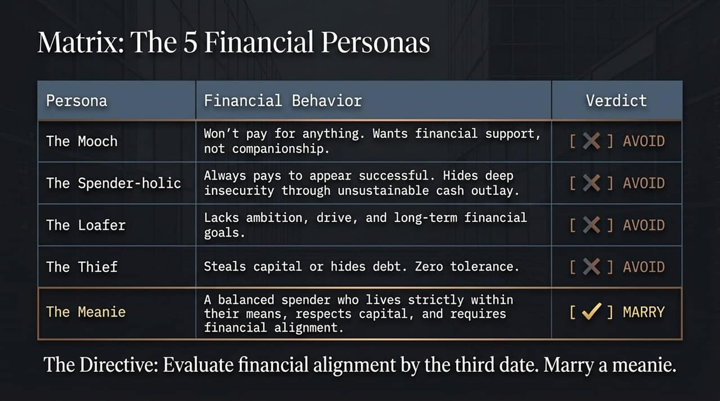
Notes:
The 4 Red Flags to Avoid: By the third date, you need to understand how a prospective partner views money. Watch out for these four personas:
The Mooch: Expects financial support without contributing.
The Spender-holic: Uses flashy spending to cover insecurities.
The Loafer: Lacks ambition, financial drive, and goals.
The Thief: Deceptive, hides debts, or mishandles shared capital.
The Target Persona — The 'Meanie': Who should you marry? Marry a Meanie. A 'Meanie' in O'Leary terms isn't cruel; they are a prudent spending gatekeeper who lives strictly within their means, respects capital, and refuses unnecessary debt.
The Directive: Ensure total financial alignment early. Partnering with someone financially incompatible will undermine your wealth accumulation.
Transition: Now let's shift from personal strategy to technology moats in modern business.

Slide 10
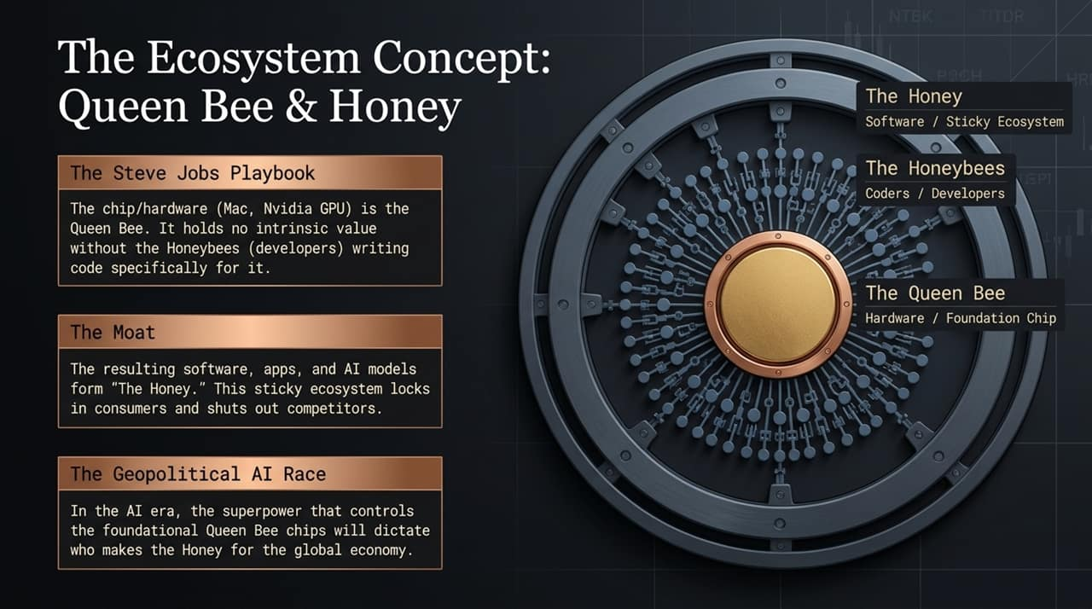
Notes:
The Framework (Steve Jobs Strategy): To build an enterprise value moat, understand the dynamic between hardware platform architectures and software ecosystems:
The Queen Bee: Foundational hardware or chips (e.g., Apple silicon, Nvidia GPUs).
The Honeybees: Developers and coders who build on the platform.
The Honey: The sticky software ecosystem that binds users to the system.
Economic Value Creation: The Queen Bee chip has little value without developers. Once developers create proprietary software ('Honey'), high switching costs create an insurmountable moat against competitors.
Geopolitical AI Implications: In the AI era, control over foundational GPU hardware ('Queen Bees') determines which nations and corporations control global AI applications.
Transition: Whether evaluating tech platforms or brand endorsements, decisions require uncompromising integrity.

Slide 11
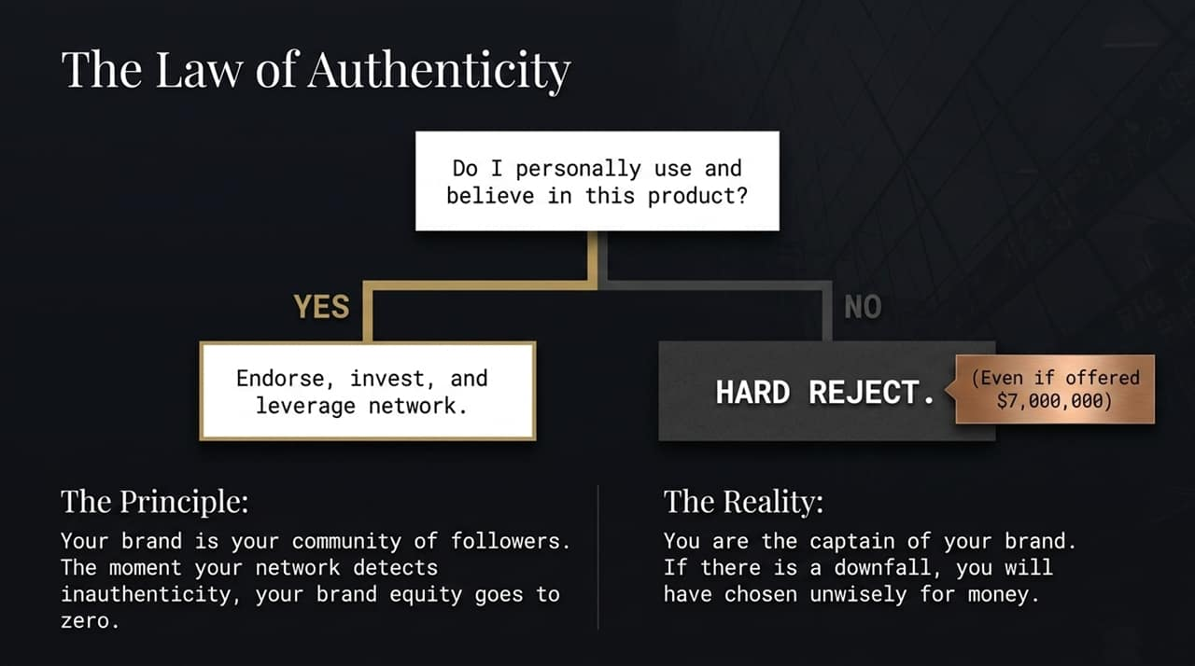
Notes:
The Core Filter: Every endorsement, partnership, or deal must pass a simple binary test: Do I personally use and believe in this product? If Yes, endorse it fully. If No, reject it immediately.
Resisting the Paycheck Trap: As Kevin noted in his discussion on deal-making, promoters may offer massive sums—millions of dollars—to endorse sub-par products. Taking short-term money for an inauthentic product instantly destroys your brand equity.
Key Takeaway & Transition: Your brand equity is built over decades and can be destroyed in seconds. You are the captain of your brand; never sacrifice long-term credibility for short-term gain.

Slide 12
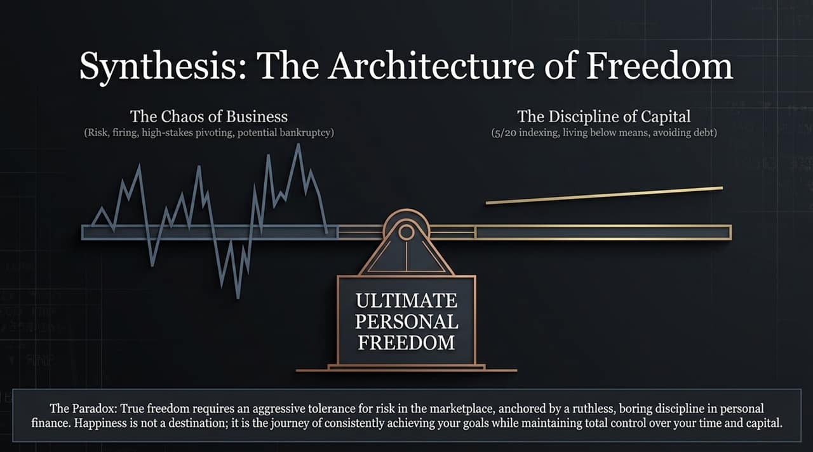
Notes:
The Core Paradox: Achieving true independence requires balancing two opposing forces:
Aggressive Business Risk: Embracing market chaos, firing low performers, pivoting, and taking calculated risks.
Boring Personal Capital Discipline: Applying strict 5/20 indexing, avoiding bad debt, capping housing costs, and living below your means.
Defining True Happiness: Happiness is not a static destination or a bank balance. Happiness is the continuous process of setting, pursuing, and achieving meaningful goals while retaining total control over your time.
Transition: To wrap up our discussion, let's review the summary cheat sheet of the O'Leary Protocol.

Slide 13
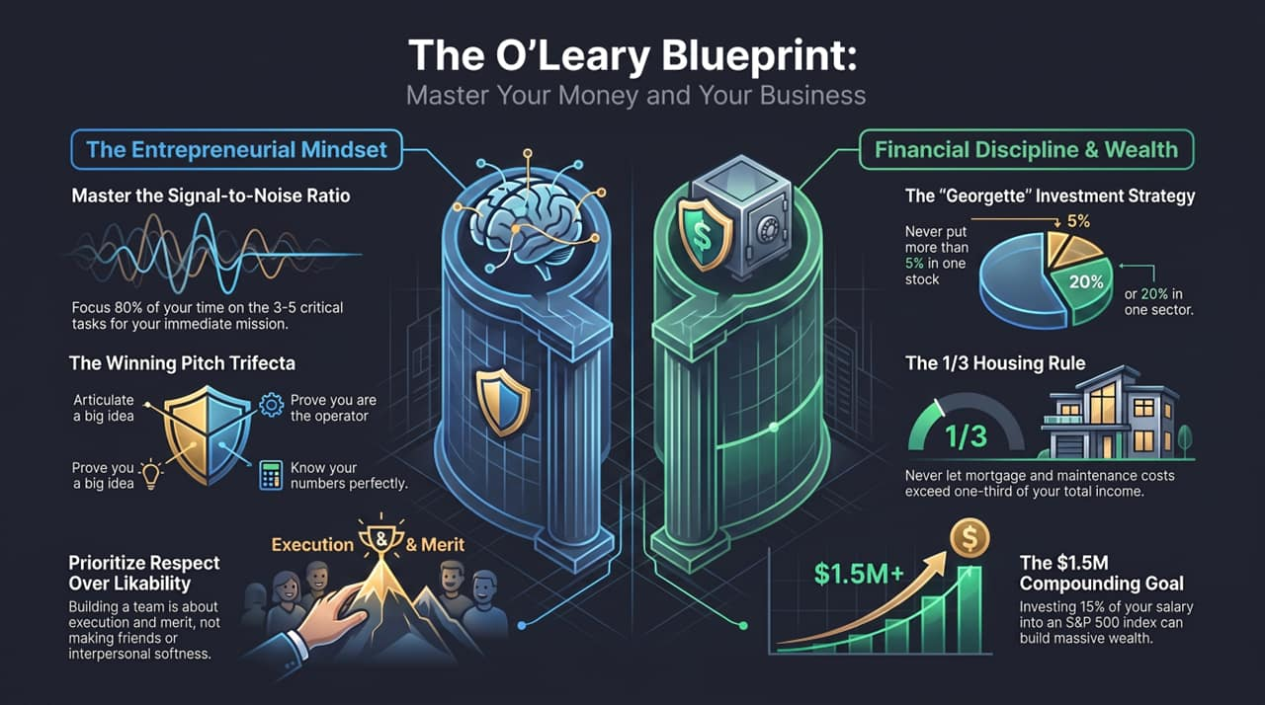
Notes:
The Master Checklist: To summarize the core principles of the O'Leary Blueprint:
Signal vs. Noise: Direct 80% of your daily focus to your top 3 to 5 tasks.
Pitching: Master presence, prove execution capability, and know your metrics.
Team Building: Prioritize execution merit over likability.
Investing: Stick to the 5% single-stock and 20% sector caps.
Financial Rules: Cap housing costs at 33.3% of income and consistently invest 15% into index funds.
Closing Call to Action: Take control of your capital, focus on what matters, and build your own store. Thank you.

